Slide 1
Basic Java
Unit 1 - Introduction to Java

Slide 2

Introduction and Logistics
Introduction
  About me
  About you
Logistics
  Class timings : 9.00 am to 6.00 pm
  Lunch Break : 1pm to 2pm
  Coffee Breaks : 11 - 11.15 am & 3.30 – 3.45 pm
Please switch off cell phones and Instant Messengers

Slide 3
Topics
History of Java
The 3 editions of Java
Installation of Java
Simple Java application
JRE and JDK
How Traditional Programs Run
How Java Programs Run
Features of Java
Java Applications Vs Java Applets
Security in Java

Slide 4



History of Java
Developed at Sun Microsystems between 1991 and 1995
  Started as a small, secret project called The Green Project in 1991; headed by James Gosling and Bill Joy
James Gosling
Bill Joy
The original objective of Java was:
  to provide a platform-independent programming language and operating system for consumer electronics.
Java became popular as a language of the Web due to:
  Bytecode
  Applet
  Platform-independent nature
Notes:
Unlike popular perception, Java language was not aimed at web applications during its conception phase. It was originally aimed at creating platform-independent programming language and operating system for consumer electronics, as developing common applications to run on different devices required that programmers learn the architecture of each chip and program each one of them differently.
Since the creators of Java were veteran C++ developers, they began developing the new language with C++ as the base. All the lessons learnt in years of C++ development were applied in creating this new language. They decided to simplify the language by removing the confusing and/or rarely used features of C++. They also decided to make the language more secure and robust by enforcing best practices of C++ as rules of this new language.
Once development of the language started, it was realized that Java can solve a bigger problem than consumer electronic devices. It was during these early years in the nineties that internet was becoming popular. Java seemed to be a perfect fit for the Web since programs written in Java could quickly be transferred across the Web and be run on any platform. Hence the language was made to support web based applications.

Slide 5
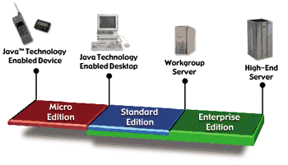
The 3 editions of Java
Java Micro Edition (JME)
Java Standard Edition (JSE)
Java Enterprise Edition (JEE)
Notes:
Micro edition : For Java applications that run on mobile phones, PDAs etc.,
Standard Edition : For PC based applications
Enterprise Edition : For Server side applications

Slide 6
The 3 editions of Java
Java Micro Edition (JME):
An application platform for Java applications to run on mobile phones, PDAs, etc.
Java Standard Edition (JSE)
Java Enterprise Edition (JEE)
Notes:
Micro edition : For Java applications that run on mobile phones, PDAs etc.,
Standard Edition : For PC based applications
Enterprise Edition : For Server side applications

Slide 7
The 3 editions of Java
Java Micro Edition (JME)
Java Standard Edition (JSE): An application platform for Java applications to run on desktops
Java Enterprise Edition (JEE)
Notes:
Micro edition : For Java applications that run on mobile phones, PDAs etc.,
Standard Edition : For PC based applications
Enterprise Edition : For Server side applications

Slide 8
The 3 editions of Java
Java Micro Edition (JME)
Java Standard Edition (JSE)
Java Enterprise Edition (JEE): Is the industry standard for developing portable, robust, scalable, and secure server-side distributed applications
Notes:
Micro edition : For Java applications that run on mobile phones, PDAs etc.,
Standard Edition : For PC based applications
Enterprise Edition : For Server side applications

Slide 9
Developing our first Java application
Pre requisites for developing a java application
  Installation
  Setting the path
Steps involved
  Write the java program
  Compile and debug compile-time errors, if any
  Execute

Slide 10
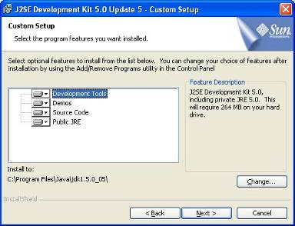
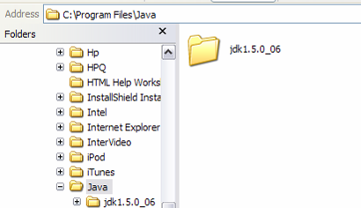
Installation of Java
1. JDK can be downloaded from Sun Microsystems Web site.
2. The JDK comes as an executable
file; on execution of the file, the JDK
would be installed on the computer.
3. Upon installation, you will be
able to view the jdk1.5 folder in
the following file path:
…/Program Files/Java.

Slide 11
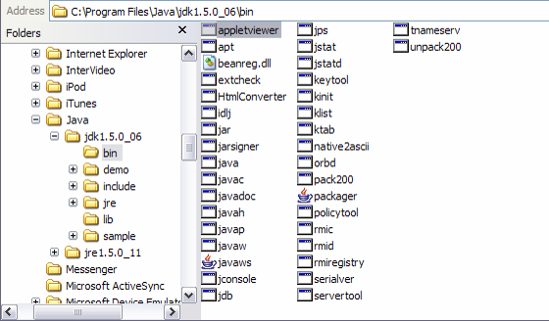
jdk/bin Folder
The jdk1.5/bin folder contains all the executable applications, such as:
  javac
  java
  javadoc
  jar
Add the bin directory to an appropriate file path:
  For example, if Java is installed in the file path, C:\Program Files,
  add C:\Program Files\Java\jdk1.5.0_06\bin to the
  environment variable path.

Slide 12
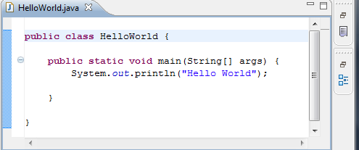
Creating a Simple Java Application
1. Open a text editor and create the source file by using the below code
2. The file should be saved with a .java extension:
In this case, name the file as HelloWorld.java
3. Compile the file in the console by using javac HelloWorld.java
4. Finally, execute the file by using java HelloWorld

Slide 13
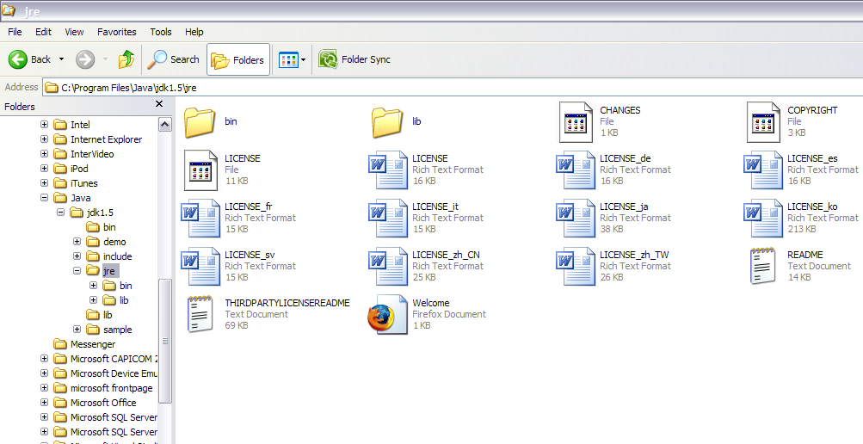
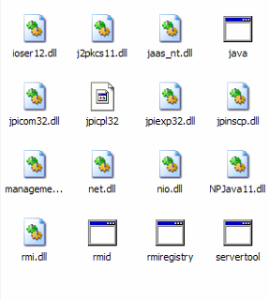
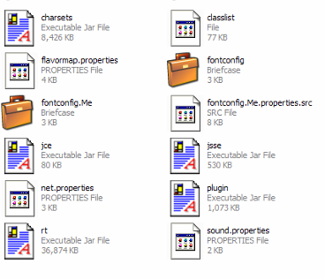
JRE (Java Runtime Environment)
JRE is found in the jdk1.5 folder:
  executables for Java Runtime are found in the jdk1.5/jre/bin folder, and
  classes from different APIs and other plug-ins are in the jdk1.5/jre/lib folder.

Slide 14
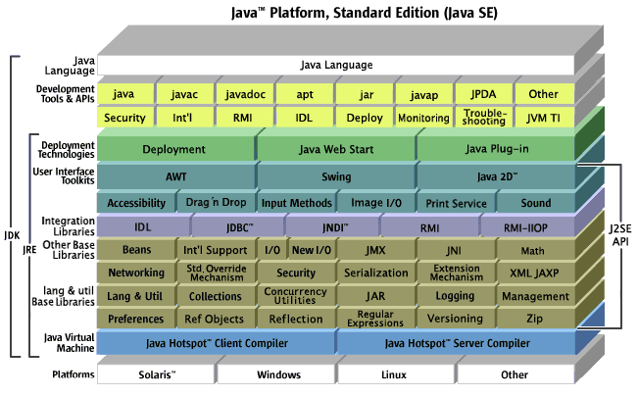
JRE and JDK
Java Development Kit (JDK) is a software required to develop Java applications.
It contains tools such as the compiler, debugger, libraries, etc.
When you install the JDK, the JRE is also installed along with it.
To run a Java application, it is enough to have JRE installed in your machines
Notes:
Java Development Kit (JDK) is a software that developers need to develop Java applications. The kit contains many development tools, such as the compiler, debugger, libraries, etc. When you install the JDK, the JRE is also installed with it.
JDK = JRE + Development Tools
To develop and test Java applications, use JDK.
Only to run Java applications, use JRE.

Slide 15
Test your skills…
Write a java program to swap values of two numbers.
Compile your code and debug compile time errors, if any
Execute the code

Slide 16
Traditional programs v/s Java programs
We will now see the difference in the execution of
  Traditional programs
  Java programs

Slide 17

Features of Java
Simple
Object-Oriented
Distributed
Portable
Interpreted
High performance
Robust
Secure
Buzz…
Buzz…
Buzzwords
Notes:
The above features are also the eight buzzwords of Java.

Slide 18
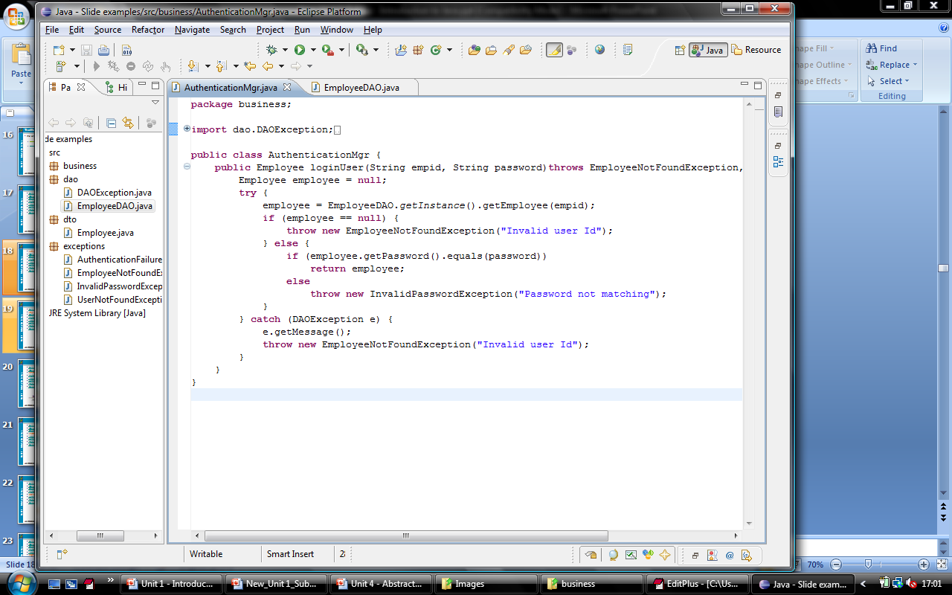
Features of Java
Simple
Object-Oriented
Distributed
Portable
Interpreted
High performance
Robust
Secure
Simple programming style
Easy to use APIs
Programmers can focus on problem-solving rather than memory-handling
Ambiguous syntax and programming constructs of C++ that made application difficult to maintain are eliminated.
Notes:
Simple:
Java borrows its style from C++, which are familiar to most programmers.
The automatic garbage collection function ensures that your focus is only on problem-solving.
Ambiguous features of C++, such as, Multiple Inheritance, Operator Overloading, etc., that made applications difficult to maintain are eliminated in Java.

Slide 19
Features of Java
Simple
Object-Oriented
Distributed
Portable
Interpreted
High performance
Robust
Secure
Default programming paradigm supported by Java is OOP.
Java retains the best Object Oriented Programming principles from C++ and Smalltalk.
All of Java’s built-in libraries are fully object-oriented.
Component
*
Button
TextField
Label
Container
Window
Panel
Frame
Dialog
Notes:
Object Oriented:
Everything is an object in Java [even main( ) method is within a class].
Unlike C++, there are no global data or global functions.
All of Java’s built-in libraries are fully object-oriented.

Slide 20
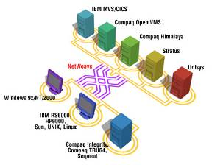
Features of Java
Simple
Object-Oriented
Distributed
Portable
Interpreted
High performance
Robust
Secure
Supports a rich set of built-in APIs for building distributed applications
Contains extensive library of routines for TCP/IP protocols
Its libraries make creating network connections easier than C or C++.
Java applications can open and access objects across the Net in a manner similar to accessing a local file system.
Notes:
Distributed:
Java supports building distributed applications with a rich set of built-in libraries.
Java has an extensive library of routines for coping easily with TCP/IP protocols, such as HTTP and FTP.
Java’s libraries make creating network connections much easier than in C or C++.
Java applications can open and access objects across the Net in a manner similar to accessing a local file system.

Slide 21
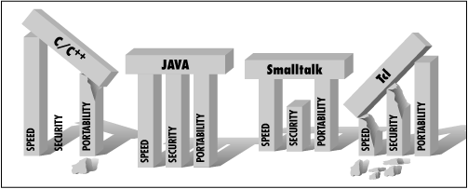
Features of Java
Simple
Object-Oriented
Distributed
Portable
Interpreted
High performance
Robust
Secure
Java is platform-independent.
  ‘Write once, run anywhere.’
The No implementation-dependency feature of Java makes it highly portable
  The language was originally conceived for portable devices.
Notes:
Portable:
Java is platform-independent:
Java applications can be written and compiled on any platform and can be run on any other platform without requiring recompilation.
The “No implementation-dependency" aspects of the specifications in Java:
Sizes of primitive data types are standardized.
The libraries that are a part of the system define portable interfaces.

Slide 22
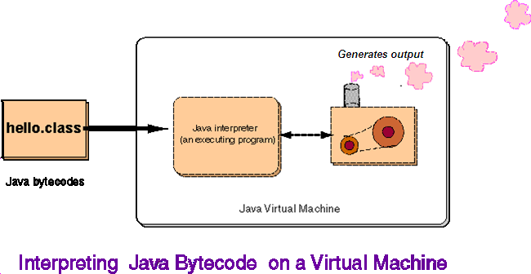
Features of Java
Simple
Object-Oriented
Distributed
Portable
Interpreted
High performance
Robust
Secure
The Java compiler does not emit platform-specific executable code.
  Produces an intermediate code called Bytecode
Java bytecodes are translated, on the fly, into native machine instructions.
Each instruction is executed by the JVM one by one (interpreted).
Notes:
Interpreted:
The Java compiler does not emit platform specific executable code; instead, it produces an intermediate code called ‘Bytecodes’. This bytecode is then interpreted on each platform.

Slide 23

Features of Java
Simple
Object-Oriented
Distributed
Portable
Interpreted
High performance
Robust
Secure
High performance. Guaranteed.
To make execution faster and simpler, the Java interpreter makes many optimizations during runtime
  Virtual memory management and garbage collection
  Inlining method calls
  JIT Compilation
The performance of bytecodes converted to machine code is similar to C or C++.
Notes:
High Performance:
In spite of being interpreted, Java is considered a high performance language because of many optimizations that the interpreter makes during runtime.

Slide 24

Features of Java
Simple
Object-Oriented
Distributed
Portable
Interpreted
High performance
Robust
Secure
What is robust ?
Refers to programs being less error prone and more stable
Provides features such as exception handling wherein the user can be forced to handle errors without fail
Is strongly typed and disallows improper conversions or casting
Contains no pointers and has its own memory-handling mechanism
Notes:
Robust:
Java as a language provides many features for making your applications robust. Robustness, in this context, refers to the program being less error prone and more stable.

Slide 25

Features of Java
Simple
Object-Oriented
Distributed
Portable
Interpreted
High performance
Robust
Secure
Java provides different levels of security, which make Java applications extremely safe.
Applications cannot forge access to data structures or private data in objects.
Notes:
Secure:
Java addresses security in many ways, making it extremely safe for a user to use Java applications.

Slide 26
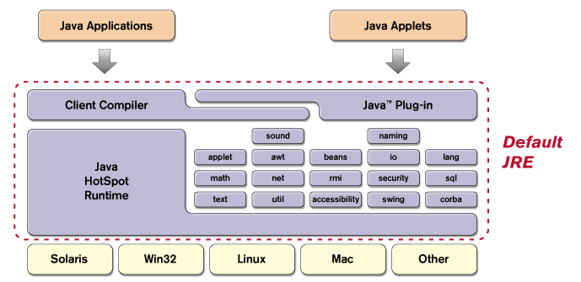
Java Runtime Environment (JRE)
JRE is the software that needs to be installed on each computer in which you want to execute Java applications.
In addition to JVM, the JRE also comprises:
  JIT compiler.
  Java Plug-in.
  Built-in APIs.
For all practical purposes, a lot of people interchangeably use the terms JRE and JVM.
Notes:
The Java API is a large collection of readymade software components that provide many useful capabilities, such as Graphical User Interface (GUI) widgets.
It is grouped into libraries (packages) of related components.
The Java API provides the core functionality of Java programming language.
The JIT compiler compiles bytecodes into platform-specific instructions. It should not be confused with Java compiler ‘javac’, which compiles source code into bytecodes. And this JIT compiler is automatically invoked by the JVM during runtime.
The Java Plug-in is used by the Internet browsers to execute Java Applets.

Slide 27
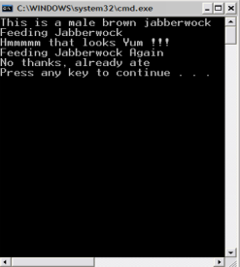
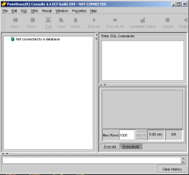
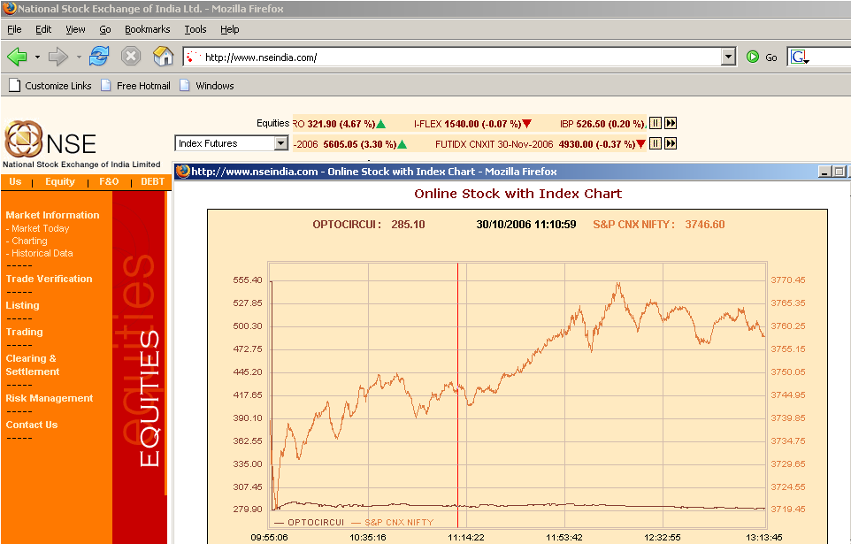
Java Applications vs Java Applets
Feature | Application | Applet
Definition
Security
Examples
A Java application is a standalone program that runs directly on JVM.
An applet, contrary to application, is embedded in Web pages. It is executed in AppletViewer or a
Java-enabled Browser.
It does need any special security restrictions.
It has some security restrictions.
Applications can be
GUI-based or console-based:
Applets are almost always GUI-based:
Stock Ticker Applet
Chart Applet
Notes:
Applets and Applications
Using the Standard Edition of Java , two types of programs can be written : Applets and Applications.
A Java application is a standalone program that runs directly on the Java VM. It is comparable to applications written in other languages such as C++, .Net etc.,
Whereas a Java applet is a Java program that runs within a Java-enabled browser. It is always embedded inside a web page. Somewhat loosely comparable to Macromedia Flash/Flex which also runs inside a browser.

Slide 28
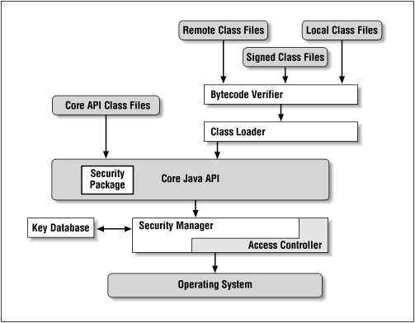
Security in Java
One of the important design goals of Java language:
‘Creation of powerful applications that could be
distributed easily over a network without jeopardizing
the users’ local security’
SandBox
Class Loader
Bytecode
Verifier
Levels of
Security
The language
and
the compiler
Notes:
Security In Java
One of the most important design goals of the Java language and the JRE was to allow creation of powerful applications that could be distributed easily over a network. Another goal was to make sure that this wide distribution model did not jeopardize the users’ local security. And that any Web user can confidently download information over the Internet and be assured that the code would not be destructive.
Both these goals have been met largely, making java unique in its ability to support both needs. Java’s security can be broadly classified into four levels, which are discussed below.
Security level one: Language and Compiler
Java language and the compiler are the first line of security for Java. Although Java takes some of its features from C++, it does not have many of the security problems of C++. For example, although C++ has ways to control access to objects (the private key word, for example), it also has ways to forge access to objects that defeat the access controls. The C++ facilities that allow forging have been eliminated in Java. Both C and C++ make extensive use of pointers, which are variables that allow you to access memory directly. Java does not directly support pointers. Java has true arrays and uses named references instead of pointers.
Another way that Java secures the integrity of your data is the way it handles data type conversions (casting). The Java compiler performs casting between numeric data types only if they do not result in data loss. Even if you use an explicit cast in your code, the Java compiler first checks whether it is legal.

Slide 29
Security in Java
One of the important design goals of Java language:
‘Creation of powerful applications that could be
distributed easily over a network without jeopardizing
the users’ local security’
SandBox
Class Loader
Bytecode
Verifier
Levels of
Security
The language
and
the compiler
Level 1: Language and Compiler
The first line of security is the Java language itself and the compiler.
Even though Java borrows some features from C++, it does not allow features such as forged access to objects or direct access to memory through pointers.
Java has true arrays and uses named references instead of pointers.
Notes:
Security In Java
One of the most important design goals of the Java language and the JRE was to allow creation of powerful applications that could be distributed easily over a network. Another goal was to make sure that this wide distribution model did not jeopardize the users’ local security. And that any Web user can confidently download information over the Internet and be assured that the code would not be destructive.
Both these goals have been met largely, making java unique in its ability to support both needs. Java’s security can be broadly classified into four levels, which are discussed below.
Security level one: Language and Compiler
Java language and the compiler are the first line of security for Java. Although Java takes some of its features from C++, it does not have many of the security problems of C++. For example, although C++ has ways to control access to objects (the private key word, for example), it also has ways to forge access to objects that defeat the access controls. The C++ facilities that allow forging have been eliminated in Java. Both C and C++ make extensive use of pointers, which are variables that allow you to access memory directly. Java does not directly support pointers. Java has true arrays and uses named references instead of pointers.
Another way that Java secures the integrity of your data is the way it handles data type conversions (casting). The Java compiler performs casting between numeric data types only if they do not result in data loss. Even if you use an explicit cast in your code, the Java compiler first checks whether it is legal.

Slide 30
Security in Java
One of the important design goals of Java language:
‘Creation of powerful applications that could be
distributed easily over a network without jeopardizing
the users’ local security’
SandBox
Class Loader
Bytecode
Verifier
Levels of
Security
The language
and
the compiler
Level 2: Bytecode Verifier
The compiler ensures that Java source code does not violate any of the safety rules.
If a Java complier that violates these rules, is written, the bytecode verifier performs these checks:
Does not forge pointers
Does not violate access restrictions
Always uses objects in the way they were intended to be used
Calls methods with appropriate arguments of the appropriate types
Causes no stack overflows
Does not try to execute any privileged or insecure instructions
Notes:
Security In Java
One of the most important design goals of the Java language and the JRE was to allow creation of powerful applications that could be distributed easily over a network. Another goal was to make sure that this wide distribution model did not jeopardize the users’ local security. And that any Web user can confidently download information over the Internet and be assured that the code would not be destructive.
Both these goals have been met largely, making java unique in its ability to support both needs. Java’s security can be broadly classified into four levels, which are discussed below.
Security level one: Language and Compiler
Java language and the compiler are the first line of security for Java. Although Java takes some of its features from C++, it does not have many of the security problems of C++. For example, although C++ has ways to control access to objects (the private key word, for example), it also has ways to forge access to objects that defeat the access controls. The C++ facilities that allow forging have been eliminated in Java. Both C and C++ make extensive use of pointers, which are variables that allow you to access memory directly. Java does not directly support pointers. Java has true arrays and uses named references instead of pointers.
Another way that Java secures the integrity of your data is the way it handles data type conversions (casting). The Java compiler performs casting between numeric data types only if they do not result in data loss. Even if you use an explicit cast in your code, the Java compiler first checks whether it is legal.

Slide 31
Security in Java
One of the important design goals of Java language:
‘Creation of powerful applications that could be
distributed easily over a network without jeopardizing
the users’ local security’
SandBox
Class loader
Bytecode
Verifier
Levels of
Security
The language
and
the compiler
Level 3: Class Loader
The class loader allocates memory space for each class and makes sure that the code is not attempting to deceive or dislodge (spoof) a built-in class.
For example, a programmer cannot write his/ her own version of the string class and have it executed instead of the built-in class. The built-in classes are always checked first.
Notes:
Security In Java
One of the most important design goals of the Java language and the JRE was to allow creation of powerful applications that could be distributed easily over a network. Another goal was to make sure that this wide distribution model did not jeopardize the users’ local security. And that any Web user can confidently download information over the Internet and be assured that the code would not be destructive.
Both these goals have been met largely, making java unique in its ability to support both needs. Java’s security can be broadly classified into four levels, which are discussed below.
Security level one: Language and Compiler
Java language and the compiler are the first line of security for Java. Although Java takes some of its features from C++, it does not have many of the security problems of C++. For example, although C++ has ways to control access to objects (the private key word, for example), it also has ways to forge access to objects that defeat the access controls. The C++ facilities that allow forging have been eliminated in Java. Both C and C++ make extensive use of pointers, which are variables that allow you to access memory directly. Java does not directly support pointers. Java has true arrays and uses named references instead of pointers.
Another way that Java secures the integrity of your data is the way it handles data type conversions (casting). The Java compiler performs casting between numeric data types only if they do not result in data loss. Even if you use an explicit cast in your code, the Java compiler first checks whether it is legal.

Slide 32
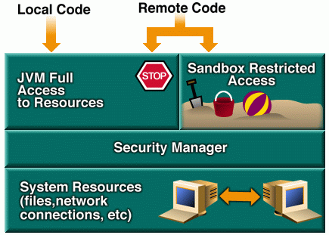
Security in Java
One of the important design goals of Java language:
‘Creation of powerful applications that could be
distributed easily over a network without jeopardizing
the users’ local security’
Sandbox
Class Loader
Bytecode
Verifier
Levels of
Security
The language
and
the compiler
Level 4: SandBox
The basic rules of SandBox security determine what a Java applet cannot do within a Web browser or in any other
container that implements this Java security approach. Java applets cannot:
delete files on the local system.
read from or write to local files.
create new directories on the local system.
inspect directory contents or check various file attributes.
execute programs on the local system.
call DLLs.
create network connections to machines other than the server from which the applet was loaded.
create objects from the core packages that manage security, such as security manager and class loader.
Notes:
Security In Java
One of the most important design goals of the Java language and the JRE was to allow creation of powerful applications that could be distributed easily over a network. Another goal was to make sure that this wide distribution model did not jeopardize the users’ local security. And that any Web user can confidently download information over the Internet and be assured that the code would not be destructive.
Both these goals have been met largely, making java unique in its ability to support both needs. Java’s security can be broadly classified into four levels, which are discussed below.
Security level one: Language and Compiler
Java language and the compiler are the first line of security for Java. Although Java takes some of its features from C++, it does not have many of the security problems of C++. For example, although C++ has ways to control access to objects (the private key word, for example), it also has ways to forge access to objects that defeat the access controls. The C++ facilities that allow forging have been eliminated in Java. Both C and C++ make extensive use of pointers, which are variables that allow you to access memory directly. Java does not directly support pointers. Java has true arrays and uses named references instead of pointers.
Another way that Java secures the integrity of your data is the way it handles data type conversions (casting). The Java compiler performs casting between numeric data types only if they do not result in data loss. Even if you use an explicit cast in your code, the Java compiler first checks whether it is legal.

Slide 33
Building Applications
All programs written in the Java language are built from classes.
Every application needs one class with the main method.
The class is the entry point for the program and is passed to the java interpreter command to run the application.
Signature of main() method
public static void main(String args[]) {…}

Slide 34
Command line arguments
Passing Command line arguments
  These arguments are then parsed according to requirements.
  The java program must handle the arguments within it.
class CmdLine
{
public static void main(String args[])
{
String name=args[0];
System.out.println(“Hello ”+name);
}
}
Execute the program as below
c:\> java CmdLine Jane

Slide 35
Test your skills…
Write a java program to accept the radius of a circle as a command line input, calculate and display the area of the circle
Compile your code and debug compile time errors, if any
Execute the code

Slide 36
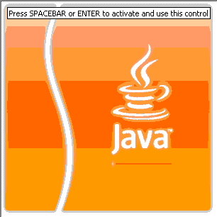

Question time
Please try to limit the questions to the topics discussed during the session. Thank you.

Slide 37
Java Runtime Environment (JRE)
JRE is the software that needs to be installed on each computer in which you want to execute Java applications.
In addition to JVM, the JRE also comprises:
  JIT compiler.
  Java Plug-in.
  Built-in APIs.
For all practical purposes, a lot of people interchangeably use the terms JRE and JVM.
Java APIs provide the core functionality of Java programming language.
They are a large collection of readymade software components for use
while developing an application.
Return
Notes:
The Java API is a large collection of readymade software components that provide many useful capabilities, such as Graphical User Interface (GUI) widgets.
It is grouped into libraries (packages) of related components.
The Java API provides the core functionality of Java programming language.
The JIT compiler compiles bytecodes into platform-specific instructions. It should not be confused with Java compiler ‘javac’, which compiles source code into bytecodes. And this JIT compiler is automatically invoked by the JVM during runtime.
The Java Plug-in is used by the Internet browsers to execute Java Applets.

Slide 38
How traditional programs run
Code written with a
specific
platform/OS in mind
Your code
----------
----------
----------
----------

Slide 39
How traditional programs run
Code written with a
specific
platform/OS in mind
Compiler (Pentium)
Your code
----------
----------
----------
----------
Compiler (PowerPC)
Code compiled on
that platform
Compiler (SPARC)

Slide 40
How traditional programs run
Binary File (Pentium)
Code written with a
specific
platform/OS in mind
Compiler (Pentium)
Your code
Binary File (PowerPC)
----------
----------
----------
----------
Compiler (PowerPC)
Code compiled on
that platform
Compiler (SPARC)
Binary File (SPARC)
Compiler then emits
executable code,
which would execute
only on that platform

Slide 41
How traditional programs run
Binary File (Pentium)
Code written with a
specific
platform/OS in mind
Compiler (Pentium)
Your code
Binary File (PowerPC)
----------
----------
----------
----------
Compiler (PowerPC)
Code compiled on
that platform
Compiler (SPARC)
Binary File (SPARC)
Compiler then emits
executable code,
which would execute
only on that platform
The source files had to be customized and compiled using different compilers for each platform.
Return
Notes:
1. In traditional languages, such as C/C++, the code had to be:
written with a specific platform/OS in mind.
compiled on that platform.
2. The compiler would then emit executable code, which would execute only on that platform.
3. If an application had to run on multiple platforms, the source files had to be customized and compiled using different compilers for each platform.
This was an expensive proposition if an application had to run on different platforms.

Slide 42
How Java programs run
myProgram.java_
_____________
_____________
____________
Compiler
1. A Java program is
compiled by the compiler.

Slide 43
How Java programs runs
myProgram.java_
_____________
_____________
____________
myProgram.class
_____________
____________
___________
Compiler
1. A Java program is
compiled by the compiler.
2. After compilation, it is translated into
an intermediate language called java
bytecodes, which are platform-
independent.

Slide 44

How Java programs runs
myProgram.java_
_____________
_____________
____________
myProgram.class
_____________
____________
___________
Compiler
Interpreter
1. A Java program is
compiled by the compiler.
0010110100…
2. After compilation, it is translated into
an intermediate language called java
bytecodes, which are platform-
independent.
My Program
3. These platform-independent
bytecodes are interpreted by the Java
interpreter to run the application.

Slide 45
How Java programs runs
myProgram.java_
_____________
_____________
____________
myProgram.class
_____________
____________
___________
Compiler
Interpreter
1. A Java program is
compiled by the compiler.
0010110100…
2. After compilation, it is translated into
an intermediate language called java
bytecodes, which are platform-
independent.
My Program
The compilation happens only once.
The interpretation occurs each time the program is executed.
Therefore, each Java program is compiled as well as interpreted.
3. These platform-independent
bytecodes are interpreted by the Java
interpreter to run the application.
Return
Notes:
Each Java program is both compiled and interpreted. With a compiler, a Java program is translated into an intermediate language called Java bytecodes --the platform-independent codes interpreted by the Java interpreter. With an interpreter, each Java bytecode instruction is parsed and run on the computer. Compilation happens just once; interpretation occurs each time the program is executed.

Slide 46
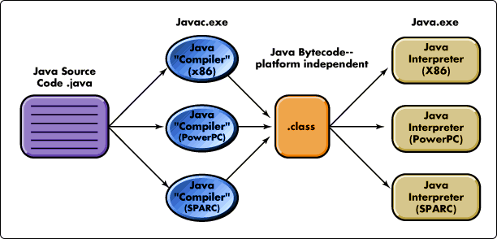
Java Bytecode
The Java complier compiles the source program *.java file into an intermediary .class file.
The .class file contains bytecodes – the machine language of Java run-time system
Bytecode is the magic behind
  “Write Once, Run Anywhere”^{tm}
Bytecode is executed by Java run-time system
Return
Notes:
Each Java program is both compiled and interpreted. With a compiler, a Java program is translated into an intermediate language called Java bytecodes --the platform-independent codes interpreted by the Java interpreter. With an interpreter, each Java bytecode instruction is parsed and run on the computer. Compilation happens just once; interpretation occurs each time the program is executed.

Slide 47
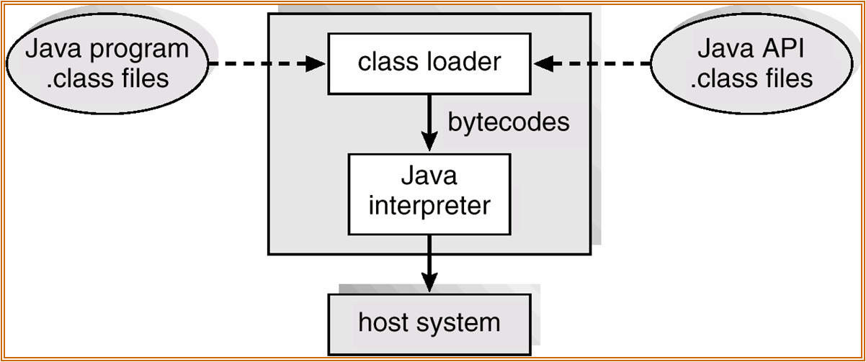
Java Virtual Machine (JVM)
JVM is an abstract computer on which all Java programs run.
It interprets the bytecodes to the underlying system.
JVM:
  Allows cross-platform delivery
  Results in small size of compiled code
  Provides high-level security
Return
Notes:
Java Runtime Environment consists of JVM.
The JVM is an abstract computer on which all Java programs run.
Bytecodes are the machine language of the JVM.
The JVM interprets the bytecodes to the underlying system.

Slide 48
Just In Time (JIT) compilation
Java Virtual Machine (JVM - interpreter)
Java Application
(Bytecode) __
___________
___________
JVM
Converts instructions into machine
language as each one is encountered

Slide 49
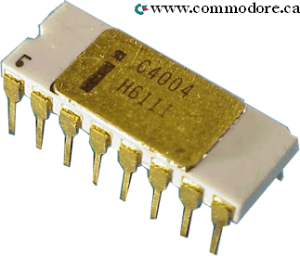
Just In Time (JIT) compilation
Java Virtual Machine (JVM - interpreter)
Java Application
(Bytecode) __
___________
___________
JVM
Native machine
language
_____________
___________
Converts instructions into machine
language as each one is encountered

Slide 50
Just In Time (JIT) compilation
Java Virtual Machine (JVM - interpreter)
Java Application
(Bytecode) __
___________
___________
JVM
Native machine
language
_____________
___________
Converts instructions into machine
language as each one is encountered
Just-In-Time (JIT) Compiler (faster)
Java Application
(Bytecode) __
___________
___________
Native Machine
Language __
___________
___________
JIT Compiler
Converts all instructions into machine
language as needed
Runs the machine language

Slide 51
Just In Time (JIT) compilation
Java Virtual Machine (JVM - interpreter)
Java Application
(Bytecode) __
___________
___________
JVM
Native machine
language
_____________
___________
Converts instructions into machine
language as each one is encountered
Just-In-Time (JIT) Compiler (faster)
Java Application
(Bytecode) __
___________
___________
Native Machine
Language __
___________
___________
JIT Compiler
Converts all instructions into machine
language as needed
Runs the machine language
Different implementations of JVM use different algorithms.
Return
Notes:
The JIT compiler compiles bytecodes into platform-specific instructions.
The JIT compiler can be used to:
speed up execution.
offset the cost of interpretation.
Different implementations of JVM use different algorithms.
Overall, the JIT compiler improves performance while using relatively more memory.

